Slide 1



New drugs for Dengue fever A READDI-AViDD subproject update
Faculty of Life Sciences, School of Pharmacy
Rebecka Isaksson
Dec 8, 2023

Slide 2
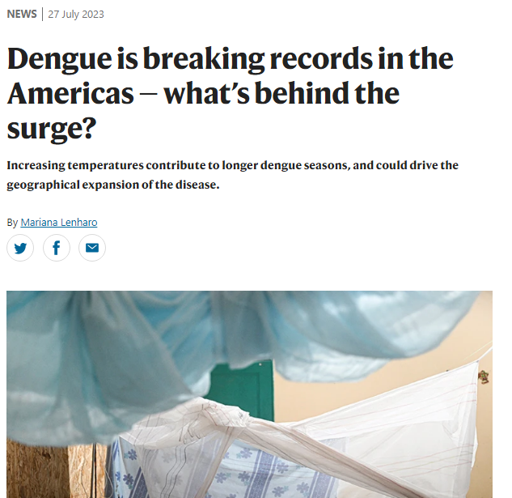
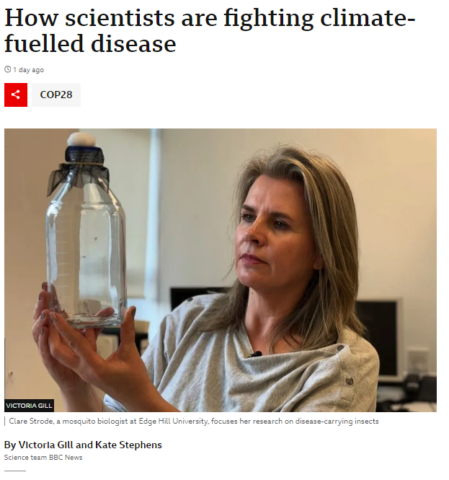
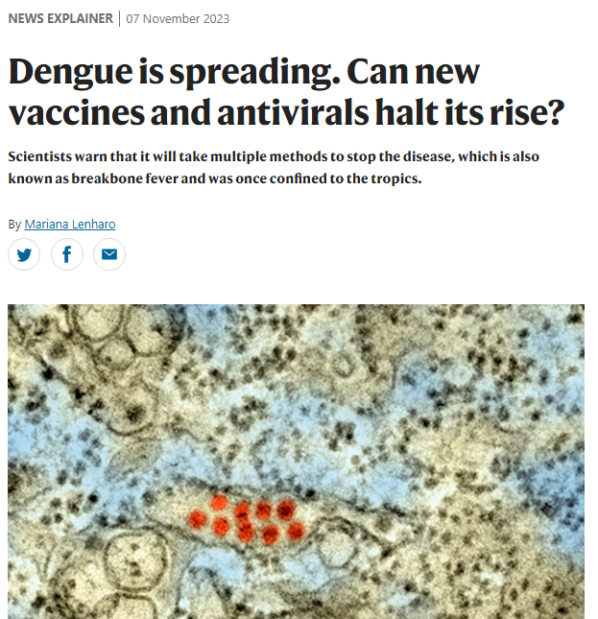
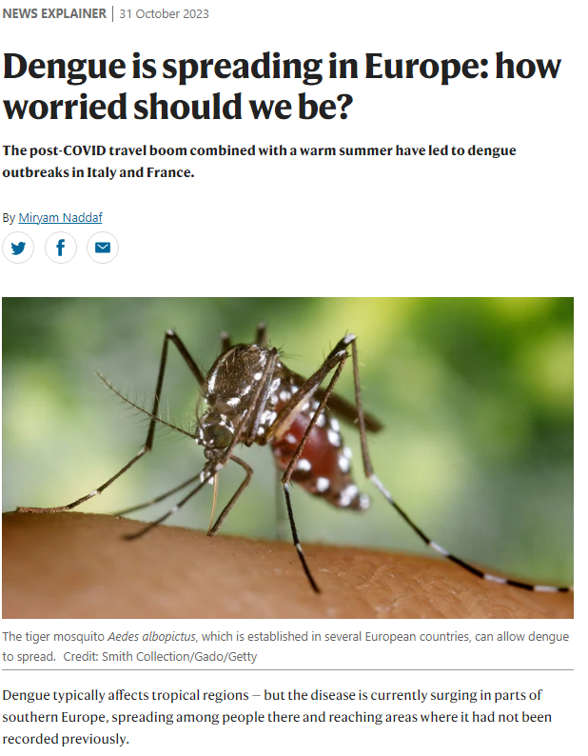
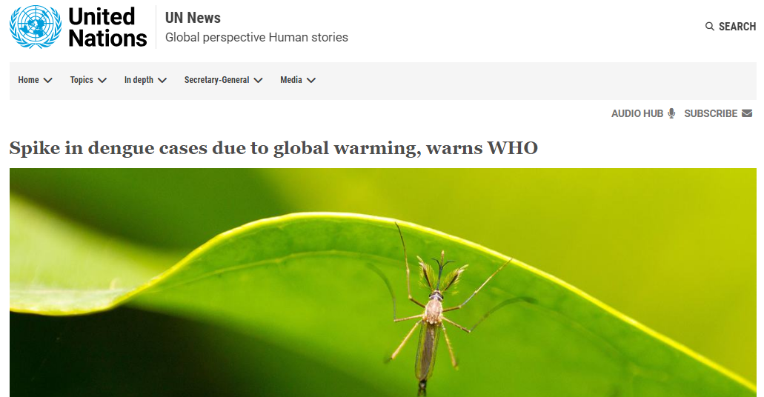
Dengue – why should we care?
BBC News, 6 Dec 2023, https://www.bbc.co.uk/news/science-environment-67591422
Nature News Explainer, 7 Nov 2023, https://www.nature.com/articles/d41586-023-03407-6
Nature News, 27 July 2023, https://www.nature.com/articles/d41586-023-02423-w
UN News, 21 July 2023, https://news.un.org/en/story/2023/07/1138962
Nature News Explainer, 31 October 2023, https://www.nature.com/articles/d41586-023-03407-6

Slide 3
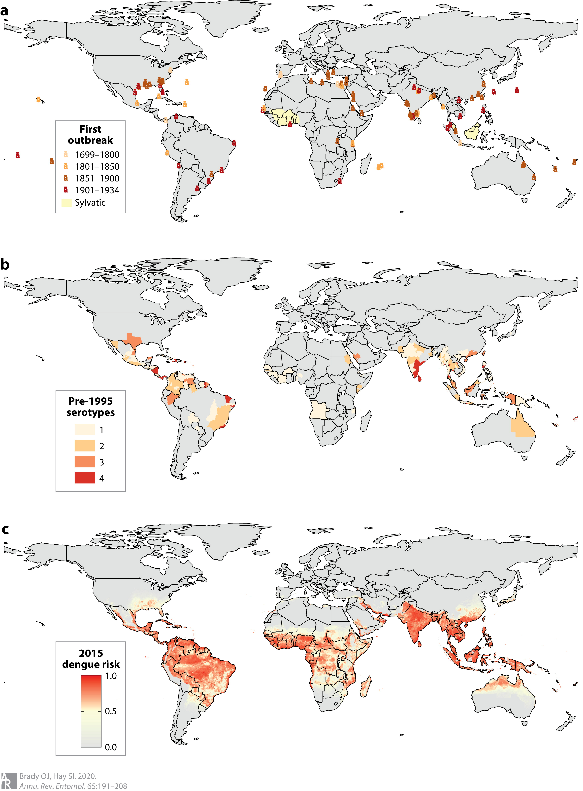
Dengue fever
Caused by flavivirus spread by mosquitos (Aedes aegypti)
4 serotypes: different antibody interaction, but same disease
Share 65% of their genome
0.5 million cases reported in 2000 → 5.2 million in 2019
Estimated infections: 100-400 million yearly
Symptoms similar to flu or cold infections, normally mild
Up to 60% of infected have little or no contact with healthcare
Sometimes develop into severe dengue with vascular leakage
Unusual to die
No drugs on the market – 2 in phase 2/3
Vaccines – in development and on market (pulled from some)
Brand and Hay, 2020, The Global Expansion of Dengue: How Aedes aegypti Mosquitoes Enabled the First Pandemic Arbovirus; https://doi.org/10.1146/annurev-ento-011019- 024918
WHO Fact Sheet, 17 March 2023, https://www.who.int/news-room/fact-sheets/detail/dengue-and-severe-dengue

Slide 4
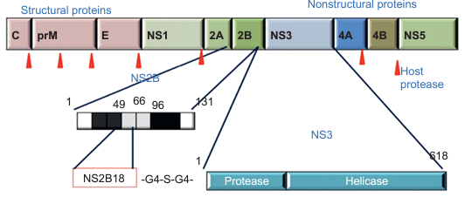
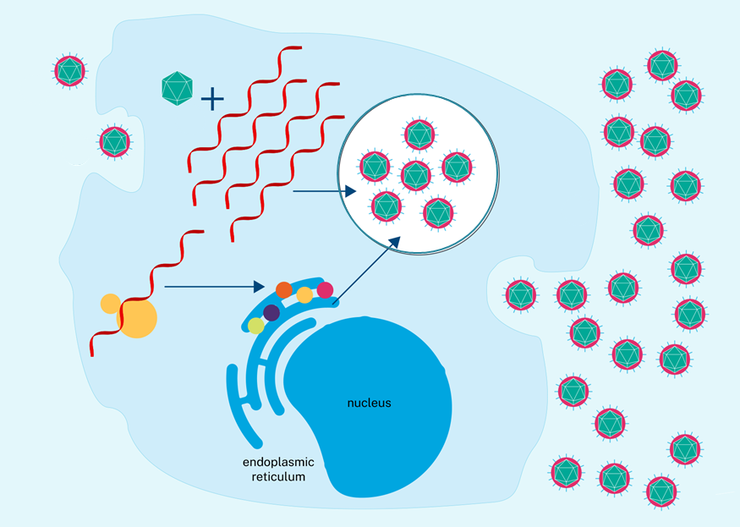
Dengue RNA-dependent RNA polymerase (RdRp)
RdRps are essential to the viral life cycle
Catalytic core highly conserved
In DENV – RdRp part of non-structural protein 5 (NS5)
Amino acids 270-900
RdRp synthesis of complementary RNA strand
Nucleoside triphosphate bind → closed conformation
Catalytic site active → elongate chain via phosphodiester bond
Catalytic site unstable → open conformation
RNA template strand move
Viral lifecycle
Venkataraman et al., Viruses. 2018, doi: 10.3390/v10020076
Viral Polymerase, Elsevier, 2019, https://doi.org/10.1016/C2017-0-02951-8
Pathania et al., J Mol Struct. 2022, doi: 10.1016/j.molstruc.2021.131756

Slide 5
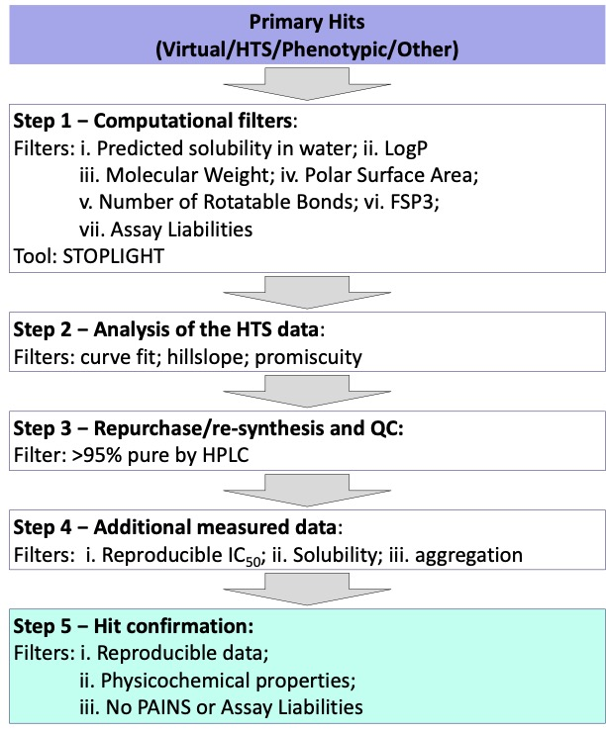
Chemistry work-cascade
Protocol developed by UNC team
Guide compound filtering and initial hit identification
Computational filters
Analysis of data
Compound validation and quality control
Additional testing (assays)
Hit confirmation
https://openlabnotebooks.org/avidd-filters-compound-filtering-sop-for-hit-to-lead/

Slide 6
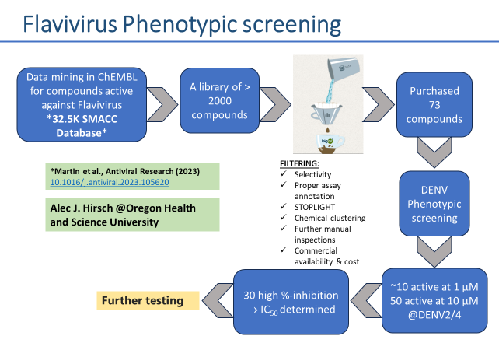

Phenotypic screening – GitHub CNP9
Martin et al., Antiviral Research, 2023, DOI: 10.1016/j.antiviral.2023.105620

Slide 7
CNP9: ChEMBL/SMACC - Flaviset
Compound evaluation:
Phenotypic assay (×2)
Protein binding
Solubility
Promiscuity
Toxicity (CC₅₀)
hmtRNAP interaction
All compounds showed good binding
No compounds passed toxicity/hmtRNAP
New filter → many PAINs

Slide 8
CNP9: ChEMBL/SMACC – Flaviset ONGOING
Return to phenotypic screen:
Remove any with tox issue
Screen out possible PAINs
Check what has been done in literature
Remove any with wide exploration already
Establish if explorations possible
10 active at 1 μM DENV2

Slide 9
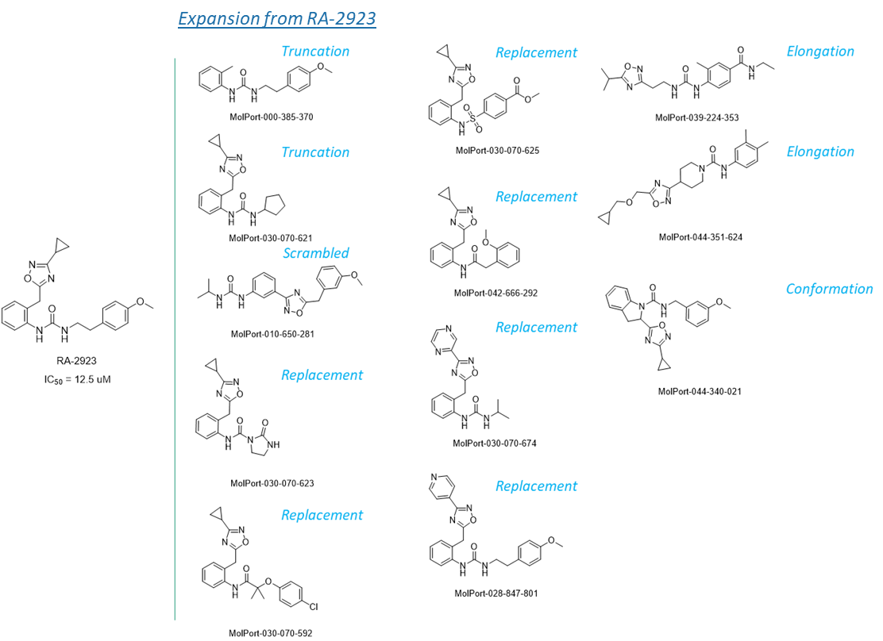

High-throughput screening #1 – GitHub CNP11
HTS on Life Chemicals 50K diversity library
74 compounds selected for IC₅₀
6 cmpds with IC₅₀ < 35 μM
Compound evaluation
Phenotypic assay
Protein binding
Solubility
hmtRNAP interaction
One promising compound with good activity and no hmtRNAP activity
SAR expansion started
50 new compounds from screen to be tested

Slide 10

High-throughput screening #2 – GitHub CNP17
HTS on Enamine 6K covalent library
62 compounds selected for IC₅₀
15 cmpds with IC₅₀ < 20 μM
Compound evaluation
Phenotypic assay
Protein binding
Promiscuity
hmtRNAP interaction
4 of 6 compounds show assay interference
Remaining 2 (RA-2478 and RA-3118):
No phenotypic activity
hmtRNAP active
Active on multiple targets

Slide 11
CNP17: Enamine Covalent
After removing picogreen false positives (assay interference)
9 compounds with IC₅₀ < 20 μM
1 compound flagged as PAIN
HTS comparison with other AViDD screens
Fluorosulfonyl-pyridine favoring DENV
SAR expansion started

Slide 12
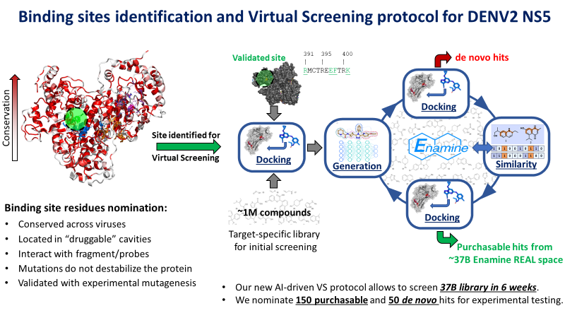

Virtual screening campaign: GitHub CNP18
Konstantin Popov
@University of North Carolina

Slide 13
CNP18 – Enamine REAL, Virtual screen
Selection from virtual screen was inactive in DENV2 Rdrp picogreen assay
Compounds submitted to phenotypic screen on DENV2 and DENV4 (1 and 10 μM)
9 compounds showed promising inhibition and submitted to EC₅₀
1 compound flagged as possible PAIN
3 compounds showed EC₅₀ <10 μM
SAR expansion started

Slide 14
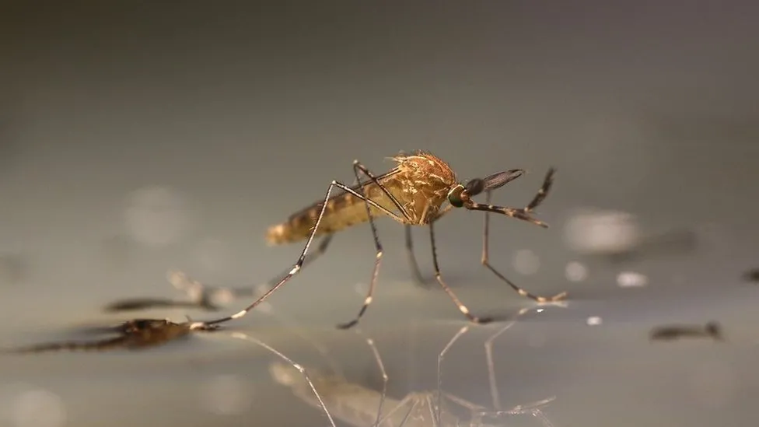
Summary of series explored – DENV Rdrp
Phenotypic screening – GitHub CNP9
ChEMBL mined SMACC library
Step 4 – on hold due to toxicity
High-throughput screening #1 – GitHub CNP11
Life Chemicals diversity library 50K
Step 3 – SAR expansion
High-throughput screening #2 – GitHub CNP17
Enamine covalent library 6K
Step 3 – SAR expansion
Virtual screening – GitHub CNP18
Enamine REAL library
Step 3 – SAR expansion

Slide 15
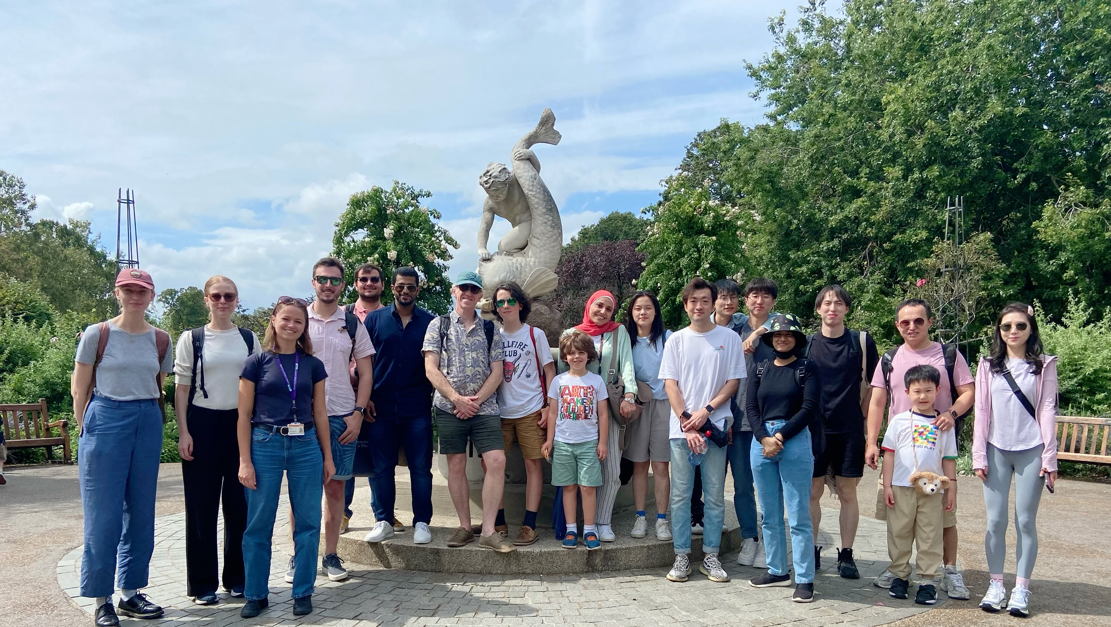

Thank you!

